Slide 1
Activator - Supply
Scenario: Imagine you are beginning a landscaping business in your neighborhood. One of your neighbors tells you they are willing to pay you $30 a week for your services, which includes mowing their lawn, edging, and weed whacking. You tell them, “It’s a deal!” and agree to mow their lawn 4 times a month. A second neighbor tells you that they will pay you $20 a week for your services. You think to yourself, “Well, it’s not as good a deal as the first neighbor, but I’m just starting out”, and you agree to mow their lawn 2 times a month. The third neighbor you approach tells you that they are willing to pay you $10 a week for your services. You tell them that you will service their lawn 1 time a month because they are a friend of the family. The 4th person offers you $5, and you politely decline.
Price for Landscaping Service
Price For Lawn Mowing Service | Quantity Supplied
$30.00
20.00
15.00
10.00
5.00
0
1 2 3 4 5 6 7 8 9 10
From left to right, which way is the curve sloping?
Why do you think it is sloping in that direction?
Quantity Supplied

Slide 2
Activator - Supply
Activator - Supply
Scenario: Imagine you are beginning a landscaping business in your neighborhood. One of your neighbors tells you they are willing to pay you $30 a week for your services, which includes mowing their lawn, edging, and weed whacking. You tell them, “It’s a deal!” and agree to mow their lawn 4 times a month. A second neighbor tells you that they will pay you $20 a week for your services. You think to yourself, “Well, it’s not as good a deal as the first neighbor, but I’m just starting out”, and you agree to mow their lawn 2 times a month. The third neighbor you approach tells you that they are willing to pay you $10 a week for your services. You tell them that you will service their lawn 1 time a month because they are a friend of the family. The 4th person offers you $5, and you politely decline.
Price for Landscaping Service
Price For Lawn Mowing Service | Quantity Supplied
$30 | 4
20 | 2
10 | 1
5 | 0
$30.00
20.00
15.00
10.00
5.00
0
1 2 3 4 5 6 7 8 9 10
Which way is the curve sloping?
Why do you think it is sloping in that direction?
Upward
Quantity Supplied
Price goes up, you are willing to supply more

Slide 3
Supply
Supply – the amount of good and services that sellers are willing and able to sell in the marketplace
The amount of a product that is offered for sale by a firm(s) at all possible prices

Slide 4
The Law of Supply
Law of Supply – the higher the price offered, the larger the quantity (amount) produced by the supplier; the lower prices offered, the lower quantity supplied
Direct (positive) relationship between price and the QS of a product.
Price As Prices
Increase
Supply Quantity Supplied
Increases
Price
As Prices
Fall
Supply
Quantity
Supplied
Falls

Slide 5
Push Up Example or Production
Extra Credit (Price) | Push Ups (Quantity Supplied)
.000000001
1
3
100%

Slide 6
The Law of Supply

Slide 7
The Law of Supply
Average Price Per Home (in thousands) | Quantity
130 | 1
150 | 3
200 | 6
250 | 9
300 | 12

Slide 8
The Supply Schedule and Curve
Supply Schedule - a table showing how much of a product a firm(s) will supply at different prices
Supply Curve – a graphic illustration of the supply schedule, which shows how much of a product a firm will supply at different prices.
Average Price Per Home (in thousands) | Quantity
$130 | 1
150 | 3
200 | 6
250 | 9
300 | 12
Price per home
$300
250
200
150
130
100
0
1 3 5 7 9 12
Quantity Supplied of Slices of Pizza

Slide 9
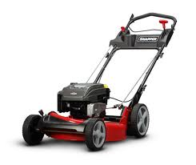
Increased Supply
Changes in the Ability to Supply
Scenario: You have been producing for a number of months at the same rate in your landscaping business. In fact, many of your neighbors have requested your services. However, you have previously been unable to fulfill their demand for your services because you are still a full time student and you have to share your time running your business with your time at school. However, the past three months of revenue have allowed you to upgrade your lawnmower from a push to a riding lawnmower. You also recently purchased a gas powered weed whacker and edger. This allows you to more than double your production rate as a result of increased efficiency.

Slide 10
Increase in Supply
Price For Lawn Mowing Service | Original Quantity Supplied
$30.00 | 4
20.00 | 2
10.00 | 1
5.00 | 0
Quantity Supplied New Equipment
8
5
3
2
Price
$30.00
20.00
10.00
S1
S2
0
1 2 3 4 5 6 7 8 9 10
Quantity Supplied

Slide 11
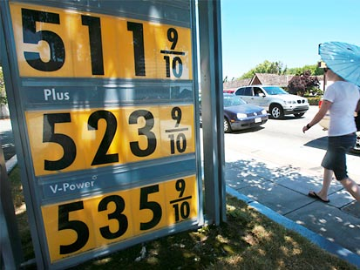
Changes in the Ability to Supply
Unfortunately, a month into your new production rates gas prices rise. This causes you to have to cut back on production and reduces your ability to supply your service.

Slide 12
Changes in Supply
Unfortunately, a month into your new production rates gas prices triple. This causes you to have to cut back on production and decrease your supply. Plot the new supply schedules on your supply curve.
Price For Lawn Mowing Service | Original Quantity Supplied
$30.00 | 4
20.00 | 2
10.00 | 1
5.00 | 0
Quantity Supplied New Equipment
8
5
3
2
Quantity Supplied Increase Gas Prices
3
1
0
0
Price
S3
$30.00
20.00
10.00
S1
S2
0
1 2 3 4 5 6 7 8 9 10
Quantity Supplied

Slide 13
Shifts of the Supply Curve
Changes in supply are reflected on the Supply Graph as a shift in the curve
Shifts to the right indicate an increase in the ability to supply (good for the firm)
Easier to produce
Shifts to the left indicate a decrease in the ability to supply (bad for the firm)
Harder to produce
Price
Increase
in supply
Decrease
in supply
S ₃
S ₁
S ₂
0
Quantity Supplied

Slide 14
What Shifts The Supply Curve? Determinants of Supply
Input Costs
Technology
Government Subsidies
Taxes
Government Regulation
Business Expectations
Supply Shocks

Slide 15
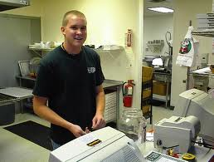
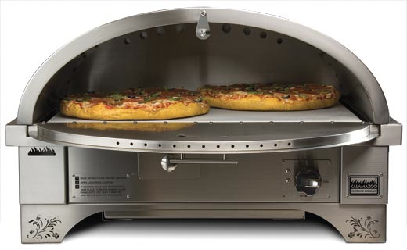
Input Costs
Land
Labor
Capital

Slide 16
Input Costs
P
S1
S
$7.25 x 40 hours = $290
$290 x 4 weeks = $1160
$1160 x 5 workers = $5800
$5800 x 12 months = $69,600
$9.00 x 40 hours = $360
$360 x 4 weeks = $1440
$1160 x 5 workers = $7200
$5800 x 12 months = $86,400

Slide 17
Why Have Corn Prices Increased?
Drought and Ethanol

Slide 18
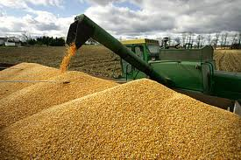
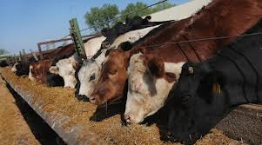
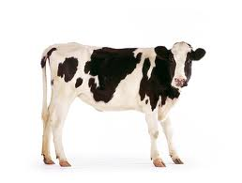
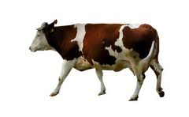
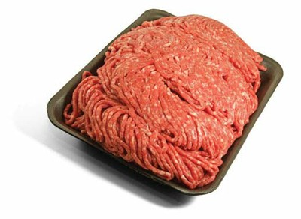
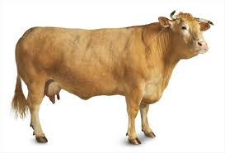
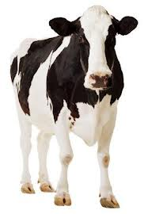
Why Have Beef Prices Risen?
P
S1
0
S
QD

Slide 19
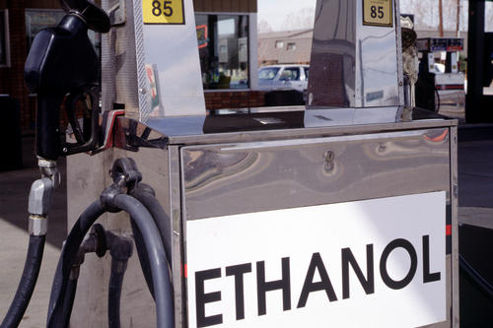
Input Costs
Input Costs – the cost of producing the good increases/decreased based on the materials necessary to produce (inputs)
Inputs necessary to produce are land, labor, capital

Slide 20
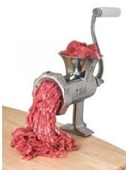
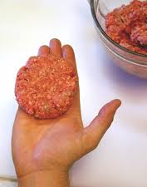
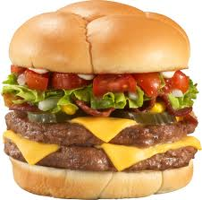
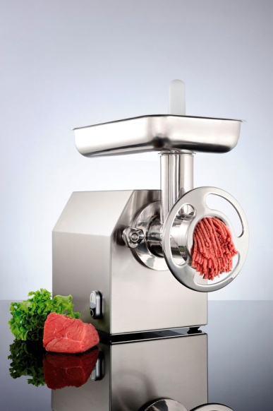
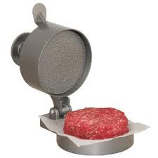
Technology
Inputs | Outputs

Slide 21
Technology and Innovations
Technological innovations improve the ability to produce and increase ability to supply

Slide 22
Government Payments

Slide 23
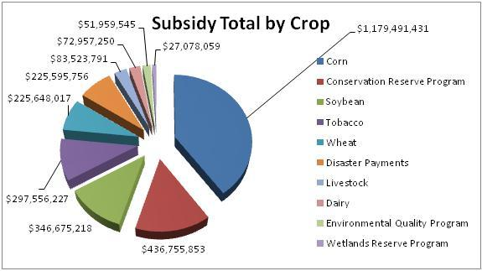

Slide 24
Subsidies
Subsidy – a government payment that supports a business or market
Subsidies motivate firms to produce because they are guaranteed revenue from the government

Slide 25
Taxes

Slide 26
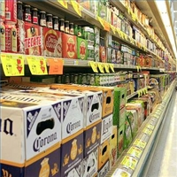
Taxes
Taxes – imposed payments to the government on the production or sale of a good or service
Excise tax (sin tax) on sale of a good or service that is harmful to the consumer
Increased taxes reduce the incentive to produce

Slide 28
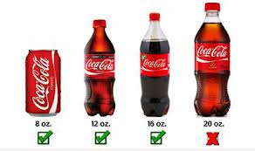
Government Regulation

Slide 29
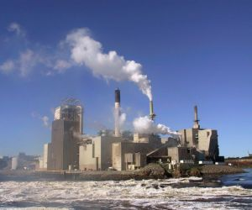
Regulation
Regulation – government oversight/influence in a market
Imposed regulations increase the cost of production and will reduce the incentive to produce

Slide 30
Business Expectations

Slide 31
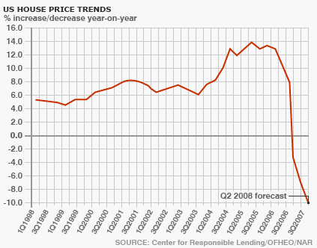
Future Expectations of Prices
Expectations – suppliers inventory will reflect how they view the economy in the future
Suppliers will build up their inventory if they feel the economy will be strong, reduce inventory if they feel it will be weak

Slide 32
Number of Sellers

Slide 33
Number of Sellers
Number of sellers – an increase/decrease in the number of sellers can cause an increase or decrease in the supply of goods and services

Slide 34
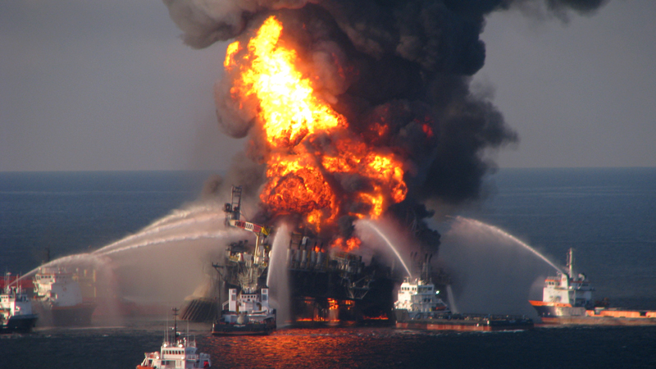
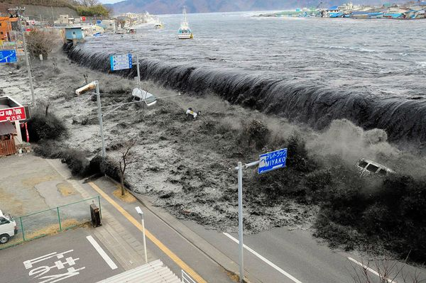
Supply Shock
Supply Shock – a sudden shortage of a good due to a natural disaster or human error
Natural disasters – drought, earthquake, hurricane
Human error – gulf oil spill, refinery fire, etc.

Slide 35
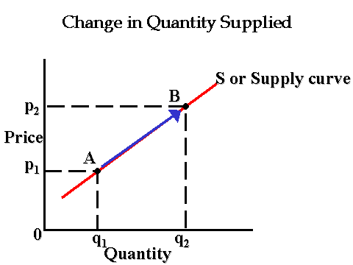
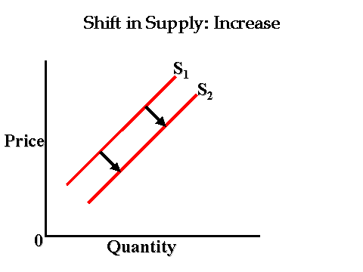
Difference Between A Change in Quantity Supplied and a Change in Supply
QS - A change in the amount a supplier will produce as a result of a change in price
Reflected as movement along the curve
S – A change in the amount a supplier can produce as a result of a change in Ceteris Peribus (i.e. investment in new machinery in lawn business)
Reflected as a shift in the curve

Slide 36
Determinants of Supply What Causes a Shift? pg. 116-120
Determinant | Example of how it can Increase supply | Example of how it can decrease supply
1. Input costs, Effect of Rising Costs
2.Technology
3.Subsidies
4.Taxes
5.Regulation
6.Future Expectations of Prices
7.Number of Sellers
A fall in the cost of inputs (raw materials) will allow more supply to be produced
A rise in the cost of inputs (machines, labor, etc.) will reduce supply
Robots have replaced human workers on assembly lines, email improves communication.
Breakdowns in technology can reduce supply.
Payments to farmers create incentive to continue to produce
Reduced incentives when government removes subsidies
Excise taxes increases costs and reduces supply
Removal of taxes decreases costs and increases supply
Government intervention increases costs and reduces supply
Government deregulation decreases costs and increases supply

Slide 37
Determinants of Supply Videos
Videos | Determinants of Supply | Increase or Decrease Supply | Shift of the supply curve
Car Production | Technology | Increase | Right
Tanning Tax | Taxes, Regulation | Decrease | Left
Gas Prices | Input | Increase | Right
Cigs | Regulation | Decrease | Left
Tablet Wars | Number of Sellers | Increase | Right
Gambling | Regulation, Number of Sellers | Decrease | Left

Slide 38
Plot the schedule below
Activator – Combining
Supply and Demand
Formula – QS - QD
Price
Price | QD
$30 | 0
25 | 2
20 | 4
15 | 6
10 | 10
5 | 15
QS
13
11
9
6
3
0
Surplus/ Shortage
30.00
Surplus
13
9
5
0
-7
-15
25.00
20.00
Equilibrium Point/ Market Clearing Price (Pe/Qe)
15.00
10.00
5.00
Shortage
S
D
0
1 2 3 4 5 6 7 8 9 10 11 12 13 14 15
Quantity

Slide 39
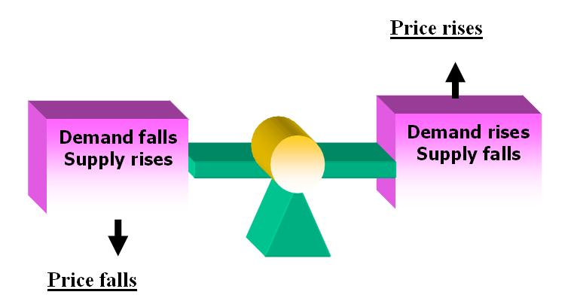
Prices
Price – the value of a product as established by supply and demand
A link between producers and consumers

Slide 40
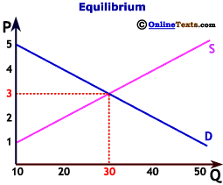
Defining Equilibrium
Equilibrium – the point of balance where demand and supply come together
Market clearing price – price that has cleared the market, accepted by both buyers and sellers
QD = QS

Slide 41
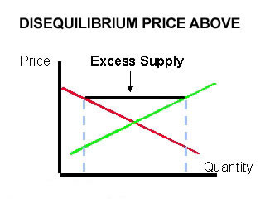
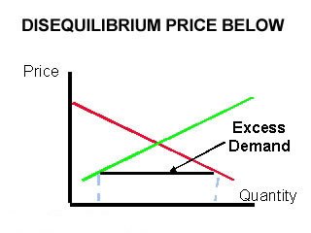
Disequilibrium
Disequilibrium – occurs when the quantity supplied is not equal to the quantity demanded
QD < QS
QD > QS

Slide 42
Excess Demand
Excess Demand – quantity demanded is greater than quantity supplied at the current price
Causes a shortage
Shortage – not enough of a product to satisfy the amount demanded by the consumer
QD > QS
Shortages puts upward pressure on price, forces prices up

Slide 43
Plot the schedule below, which represents market supply and demand and the effects of a change in demand.
Application – The Effects of a Change in Demand
Price | QD
$50 | 0
40 | 2
30 | 4
20 | 6
10 | 10
5 | 15
QS
13
11
9
6
3
0
QD (change in demand)
Price
3
5
9
13
17
25
50.00
40.00
30.00
New Equilibrium
Price/Quantity
20.00
10.00
5.00
S
D1
D2
0
1 3 5 7 9 11 13 15 17 19 21 23 25
Quantity

Slide 44
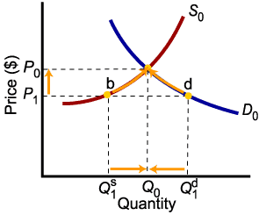
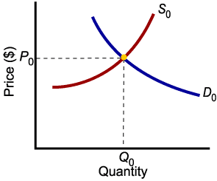
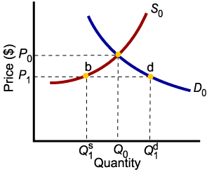
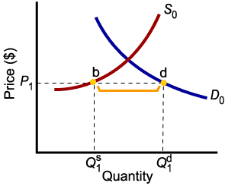
Shortages Caused by Excess Demand

Slide 45
Excess Supply
Excess Supply – quantity supplied is greater than quantity demanded at the current price
Creates a surplus
Surplus – to much of a product above what is used or needed
QD < QS
Surpluses put downward pressure on price, forcing prices down

Slide 46
Plot the schedule below, which represents market supply and demand and the effects of a change in supply.
Application – The Effects of a Change in Supply
Price | QD
$50 | 0
40 | 2
30 | 4
20 | 6
10 | 10
5 | 15
QS
13
11
9
6
3
0
20
17
15
13
10
3
Price
QS (change in supply)
50.00
40.00
30.00
20.00
New Equilibrium
Price/Quantity
10.00
5.00
S1
S2
D
0
1 3 5 7 9 11 13 15 17 19 21 23 25
Quantity

Slide 47
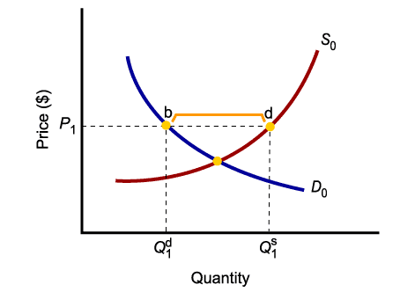
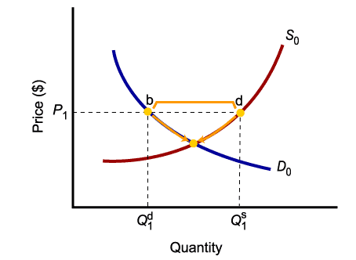
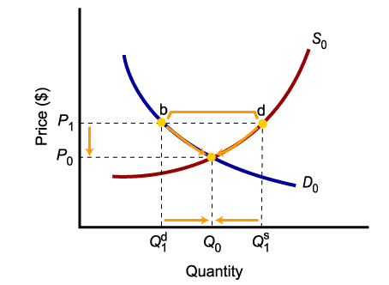
Surpluses Caused By Excess Supply

Slide 48
Law of Supply and Demand
Law of supply and demand – the price of any good adjusts to bring the quantity supplied and the quantity demanded for that good into balance reaching a market clearing price
Shortages/Surpluses are short-lived market conditions

Slide 49
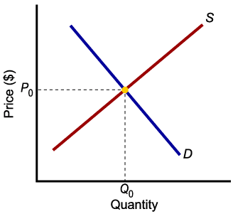
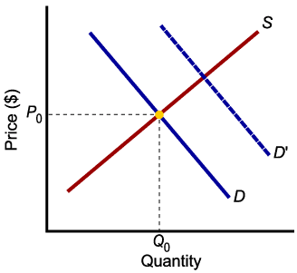
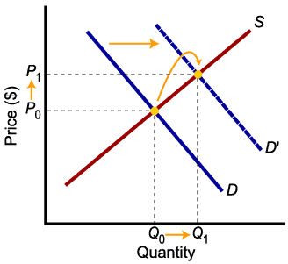
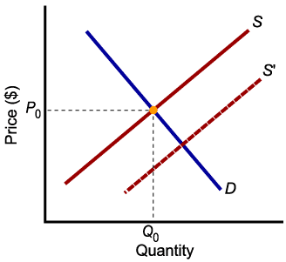
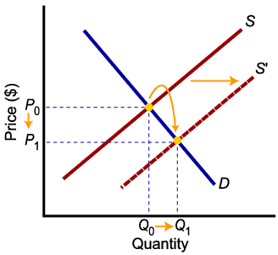
Increases in Demand and Supply
Higher demand leads to higher equilibrium price and higher equilibrium quantity.
Higher supply leads to lower equilibrium price and higher equilibrium quantity.

Slide 50
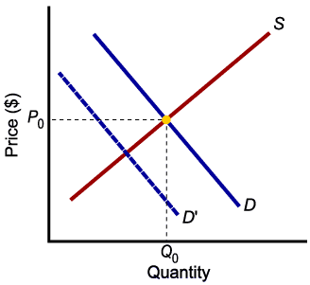
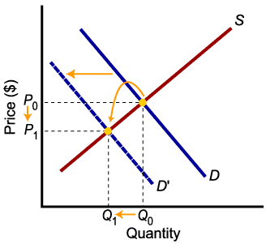
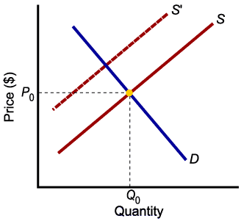
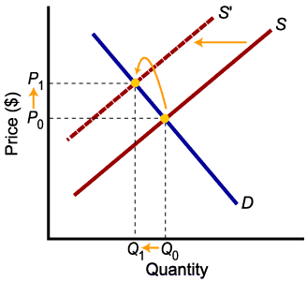
Decreases in Demand and Supply
Lower demand leads to lower price and lower quantity exchanged.
Lower supply leads to higher price and lower quantity exchanged.

Slide 51
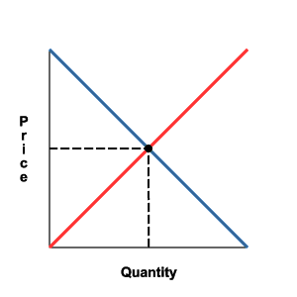
Supply and Demand Model Practice
Answer the following on a separate sheet of paper
Suppose we are analyzing the market for hot chocolate.
Winter starts and the weather turns sharply colder.
The price of cocoa beans, an ingredient in making hot chocolate, decreases.
The Surgeon General of the United States announces that hot chocolate causes acne.
Protesting farmers stop producing millions of gallons of milk.
S
D

Slide 52
Supply and Demand Model Practice
Answer the following on a separate sheet of paper
Suppose we are analyzing the market for hot chocolate.
Winter starts and the weather turns sharply colder.
The price of cocoa beans, an ingredient in making hot chocolate, decreases.
The Surgeon General of the United States announces that hot chocolate causes acne.
Protesting farmers stop producing millions of gallons of milk.
(e)
(d)
(f)
S
D

Slide 53
Survey, Question, Read, wRite, Respond Page 139 - 143
SQ3R
Prices in the Free Market
Q: How are Prices important to the free market?
A: Serve as a vital role in the economy. Help put a value on products and provide a wide range of goods at various prices.
The Advantage of Prices
Price as an Incentive
Prices as Signals
Flexibility
Price System Is “Free”
A Wide Choice of Goods
The Black Market
Efficient Resource Allocation
Prices and the Profit Incentive

Slide 54
In praise of price gouging By John Stossel Politicians and the media are furious about price increases in the wake of Hurricane Katrina. They want gas stations and water sellers punished. If you want to score points cracking down on mean, greedy profiteers, pushing anti-"gouging" rules is a very good thing. But if you're one of the people the law "protects" from "price gouging," you won't fare as well. Consider this scenario: You are thirsty — worried that your baby is going to become dehydrated. You find a store that's open, and the storeowner thinks it's immoral to take advantage of your distress, so he won't charge you a dime more than he charged last week. But you can't buy water from him. It's sold out. You continue on your quest, and finally find that dreaded monster, the price gouger. He offers a bottle of water that cost $1 last week at an "outrageous" price — say $20. You pay it to survive the disaster. You resent the price gouger. But if he hadn't demanded $20, he'd have been out of water. It was the price gouger's "exploitation" that saved your child. It saved her because people look out for their own interests. Before you got to the water seller, other people did. At $1 a bottle, they stocked up. At $20 a bottle, they bought more cautiously. By charging $20, the price gouger makes sure his water goes to those who really need it. The people the softheaded politicians think are cruelest are doing the most to help. Assuming the demand for bottled water was going to go up, they bought a lot of it, planning to resell it at a steep profit. If they hadn't done that, that water would not have been available for the people who need it the most.

Slide 55
Might the water have been provided by volunteers? Certainly some people help others out of benevolence. But we can't count on benevolence. As Adam Smith wrote, "It is not from the benevolence of the butcher, the brewer or the baker, that we can expect our dinner, but from their regard to their own interest.” Consider the storeowner's perspective: If he's not going to make a big profit, why open up the store at all? Staying in a disaster area is dangerous and means giving up the opportunity to be with family in order to take care of the needs of strangers. Why take the risk? Any number of services — roofing, for example, carpentry, or tree removal — are in overwhelming demand after a disaster. When the time comes to rebuild New Orleans, it's safe to predict a shortage of local carpenters: The city's own population of carpenters won't be enough.

Slide 56
If this were a totalitarian country, the government might just order a bunch of tradesmen to go to New Orleans. But in a free society, those tradesmen must be persuaded to leave their homes and families, leave their employers and customers, and drive from say, Wisconsin, to take work in New Orleans. If they can't make more money in Louisiana than Wisconsin, why would they make the trip? Some may be motivated by a desire to be heroic, but we can't expect enough heroes to fill the need, week after week; most will travel there for the same reason most Americans go to work: to make money. Any tradesman who treks to a disaster area must get higher pay than he would get in his hometown, or he won't do the trek. Limit him to what his New Orleans colleagues charged before the storm, and even a would-be hero may say, "the heck with it.“ If he charges enough to justify his venture, he's likely to be condemned morally or legally by the very people he's trying to help. But they just don't understand basic economics. Force prices down, and you keep suppliers out. Let the market work, suppliers come — and competition brings prices as low as the challenges of the disaster allow. Goods that were in short supply become available, even to the poor. It's the price "gougers" who bring the water, ship the gasoline, fix the roof, and rebuild the cities. The price "gougers" save lives.

Slide 57
Plot the schedule below, which represents the demand for bottled water after a hurricane.
Activator Chapter 6
Price | QD | QS
$6 | 0 | 60
5 | 10 | 50
4 | 20 | 40
3 | 30 | 30
2 | 40 | 20
1 | 50 | 0
S
6.00
5.00
4.00
3.00
2.00
Price Ceiling
1.00
D
0
10 20 30 40 50 60

Slide 58
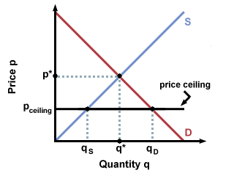
Supply, Demand, and Government Policies
Price Ceiling – government imposed, legal maximum price that can be charged for a good/service
New York introduced rent control in the early 1940s as a way to provide affordable housing
Price ceiling causes a shortage in the amount of the product

Slide 59
Plot the schedule below, which represents the demand for laborers in the market.
Activator Chapter 6
Wage | QD | QS
$7.25 | 0 | 60
6.25 | 10 | 50
5.25 | 20 | 40
4.25 | 30 | 30
2.25 | 40 | 20
1 | 50 | 0
Price Floor
S
7.25
6.25
5.25
4.25
2.25
1.00
D
0
10 20 30 40 50 60

Slide 60
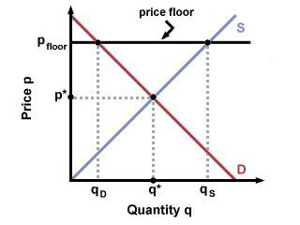
Government Intervention
Price Floor – government imposed, minimum price that can be legally charged for a good or service
Minimum wage is a well-known price floor
Minimum wage can cause a surplus of workers, causing unemployment to rise

Slide 61
Application – Price Ceiling
Price of
Ice
Cream
Cones
Scenario: the government places a price ceiling on ice cream cones as a result of complaints and lobbying from the Ice-Cream Eaters of America. The price ceiling is at $2.00 a cone. Graph the following schedule based on the price points and qs/qd.
Supply
Equilibrium
point
$3
2
Price ceiling
Shortage
of 50 cones
Demand
Price of Ice Cream Cones | Quantity Demanded | Quantity Supplied
$3 | 100 | 100
2 | 125 | 75
Quantity
supplied
Quantity
demanded
0
75 100
125
Quantity of Ice-Cream Cones
The government imposes a price ceiling of $2. Because the price ceiling is below the equilibrium price of $3, the market price equals $2. At this price, 125 cones are demanded and only 75 are supplied, so there is a shortage of 50 cones.

Slide 62
Application – Price Floor
Price of
Ice
Cream
Cones
Supply
Scenario: the government places a price floor on ice cream cones as a result of complaints and lobbying from the National Organization of Ice-Cream Makers. The price floor is at $4.00 a cone. Graph the following schedule based on the price points and qs/qd.
Surplus of Ice Cream Cones
$4
Price floor
3
Equilibrium
point
Demand
Price of Ice Cream Cones | Quantity Demanded | Quantity Supplied
$4 | 80 | 120
3 | 100 | 100
Quantity
supplied
Quantity
demanded
0
80 100
120
Quantity of Ice-Cream Cones
The government imposes a price floor of $4, which is above the equilibrium price of $3. Therefore, the market price equals $4. Because 120 cones are supplied at this price and only 80 are demanded, there is a surplus of 40 cones.

Slide 63
A store sells cheddar cheese by the pound. The schedule reflects the quantity demanded and the quantity supplied for the different prices the cheese could be sold.
Answer the following question:
What is the market price? _________
What is the quantity demanded at the market price? _______
What is the quantity supplied at the market price? _________
On your graph, draw a line across your graph at the price of $4.00.
If the government were to set a price no higher than $4.00, this would be called a __________________________
Use your answer in (a) to label the line on your graph at the price of $4.00.
At a price of $4.00, the quantity demanded would be __________
At a price of $4.00, the quantity supplied would be __________
Is there a surplus or shortage of cheese? _____________
On your graph, draw a line across your graph at the price of $5.50.
If the government were to set a price no lower than $5.50, this would be called a _________________
Use your answer in (a) to label the line on your graph at the price of $5.50.
At a price of $5.50, the quantity demanded would be _____________
At a price of $5.50, the quantity supplied would be _____________
Is there a surplus or shortage of cheese? _____________________
4.50
280
280
price ceiling
300
240
shortage
price floor
240
360
surplus

Slide 64
Tennis Ball Simulation
Number of Workers | Total Output | Marginal Product of Labor
0 | 0 | 0
What workers created the most total output?
What was the highest increase in marginal product of labor?
When did we have too many workers?

Slide 65
Costs of Production
Number of Workers | Total Output | Marginal Product of Labor
0 | 0 | -
1 | 4
2 | 10
3 | 17
4 | 23
5 | 28
6 | 31
7 | 32
8 | 31
What is the marginal product of labor from one laborer to two?_______________
What is the marginal product of labor from two laborers to three? ________________
At what number of laborers does the marginal product of labor start to decline? _________________
At what number of laborers does the firm experience negative marginal product of labor? ___________

Slide 66
Costs of Production
Number of Workers | Total Output | Marginal Product of Labor
0 | 0 | -
1 | 4 | 4
2 | 10
3 | 17
4 | 23
5 | 28
6 | 31
7 | 32
8 | 31
What is the marginal product of labor from one laborer to two?_______________
What is the marginal product of labor from two laborers to three? ________________
At what number of laborers does the marginal product of labor start to decline? _________________
At what number of laborers does the firm experience negative marginal product of labor? ___________

Slide 67
Costs of Production
Number of Workers | Total Output | Marginal Product of Labor
0 | 0 | -
1 | 4 | 4
2 | 10 | 6
3 | 17
4 | 23
5 | 28
6 | 31
7 | 32
8 | 31
What is the marginal product of labor from one laborer to two?_______________
What is the marginal product of labor from two laborers to three? ________________
At what number of laborers does the marginal product of labor start to decline? _________________
At what number of laborers does the firm experience negative marginal product of labor? ___________

Slide 68
Costs of Production
Number of Workers | Total Output | Marginal Product of Labor
0 | 0 | -
1 | 4 | 4
2 | 10 | 6
3 | 17 | 7
4 | 23
5 | 28
6 | 31
7 | 32
8 | 31
What is the marginal product of labor from one laborer to two?_______________
What is the marginal product of labor from two laborers to three? ________________
At what number of laborers does the marginal product of labor start to decline? _________________
At what number of laborers does the firm experience negative marginal product of labor? ___________

Slide 69
Costs of Production
Number of Workers | Total Output | Marginal Product of Labor
0 | 0 | -
1 | 4 | 4
2 | 10 | 6
3 | 17 | 7
4 | 23 | 6
5 | 28
6 | 31
7 | 32
8 | 31
What is the marginal product of labor from one laborer to two?_______________
What is the marginal product of labor from two laborers to three? ________________
At what number of laborers does the marginal product of labor start to decline? _________________
At what number of laborers does the firm experience negative marginal product of labor? ___________

Slide 70
Costs of Production
Number of Workers | Total Output | Marginal Product of Labor
0 | 0 | -
1 | 4 | 4
2 | 10 | 6
3 | 17 | 7
4 | 23 | 6
5 | 28 | 5
6 | 31
7 | 32
8 | 31
What is the marginal product of labor from one laborer to two?_______________
What is the marginal product of labor from two laborers to three? ________________
At what number of laborers does the marginal product of labor start to decline? _________________
At what number of laborers does the firm experience negative marginal product of labor? ___________

Slide 71
Costs of Production
Number of Workers | Total Output | Marginal Product of Labor
0 | 0 | -
1 | 4 | 4
2 | 10 | 6
3 | 17 | 7
4 | 23 | 6
5 | 28 | 5
6 | 31 | 3
7 | 32
8 | 31
What is the marginal product of labor from one laborer to two?_______________
What is the marginal product of labor from two laborers to three? ________________
At what number of laborers does the marginal product of labor start to decline? _________________
At what number of laborers does the firm experience negative marginal product of labor? ___________

Slide 72
Costs of Production
Number of Workers | Total Output | Marginal Product of Labor
0 | 0 | -
1 | 4 | 4
2 | 10 | 6
3 | 17 | 7
4 | 23 | 6
5 | 28 | 5
6 | 31 | 3
7 | 32 | 1
8 | 31
What is the marginal product of labor from one laborer to two?_______________
What is the marginal product of labor from two laborers to three? ________________
At what number of laborers does the marginal product of labor start to decline? _________________
At what number of laborers does the firm experience negative marginal product of labor? ___________

Slide 73
Costs of Production
Number of Workers | Total Output | Marginal Product of Labor
0 | 0 | -
1 | 4 | 4
2 | 10 | 6
3 | 17 | 7
4 | 23 | 6
5 | 28 | 5
6 | 31 | 3
7 | 32 | 1
8 | 31 | -1
What is the marginal product of labor from one laborer to two?_______________
What is the marginal product of labor from two laborers to three? ________________
At what number of laborers does the marginal product of labor start to decline? _________________
At what number of laborers does the firm experience negative marginal product of labor? ___________

Slide 74
Costs of Production
Number of Workers | Total Output | Marginal Product of Labor
0 | 0 | -
1 | 4 | 4
2 | 10 | 6
3 | 17 | 7
4 | 23 | 6
5 | 28 | 5
6 | 31 | 3
7 | 32 | 1
8 | 31 | -1
What is the marginal product of labor from one laborer to two?_______2________
What is the marginal product of labor from two laborers to three? ________________
At what number of laborers does the marginal product of labor start to decline? ______
At what number of laborers does the firm experience negative marginal product of labor? ______

Slide 75
Costs of Production
Number of Workers | Total Output | Marginal Product of Labor
0 | 0 | -
1 | 4 | 4
2 | 10 | 6
3 | 17 | 7
4 | 23 | 6
5 | 28 | 5
6 | 31 | 3
7 | 32 | 1
8 | 31 | -1
What is the marginal product of labor from one laborer to two?_______2________
What is the marginal product of labor from two laborers to three? _____1___________
At what number of laborers does the marginal product of labor start to decline? ______
At what number of laborers does the firm experience negative marginal product of labor? ______

Slide 76
Costs of Production
Number of Workers | Total Output | Marginal Product of Labor
0 | 0 | -
1 | 4 | 4
2 | 10 | 6
3 | 17 | 7
4 | 23 | 6
5 | 28 | 5
6 | 31 | 3
7 | 32 | 1
8 | 31 | -1
What is the marginal product of labor from one laborer to two?_______2________
What is the marginal product of labor from two laborers to three? _____1___________
At what number of laborers does the marginal product of labor start to decline? ___4___
At what number of laborers does the firm experience negative marginal product of labor? ______

Slide 77
Costs of Production
Number of Workers | Total Output | Marginal Product of Labor
0 | 0 | -
1 | 4 | 4
2 | 10 | 6
3 | 17 | 7
4 | 23 | 6
5 | 28 | 5
6 | 31 | 3
7 | 32 | 1
8 | 31 | -1
What is the marginal product of labor from one laborer to two?_______2________
What is the marginal product of labor from two laborers to three? _____1___________
At what number of laborers does the marginal product of labor start to decline? ___4___
At what number of laborers does the firm experience negative marginal product of labor? ___8___

Slide 78
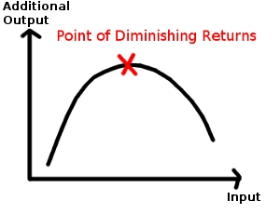
Marginal Returns
Increasing marginal returns – Increases in output per worker added by the firm
Diminishing marginal returns – Additional workers increase total output, but at a decreasing rate
Negative Marginal Returns – Adding additional workers decreases output
Number of Workers | Total Output | Marginal Product of Labor
0 | 0 | -
1 | 4 | 4
2 | 10 | 6
3 | 17 | 7
4 | 23 | 6
5 | 28 | 5
6 | 31 | 3
7 | 32 | 1
8 | 31 | -1

Slide 79
Production Costs
Fixed costs – a cost that does not change no matter how much of a good is produced
Rent, salaried employees, etc.
Variable costs – costs that rise or fall depending on the quantity produced
Electricity, hourly workers, etc.
Total cost – fixed costs and variable costs added together
Marginal cost – additional cost of producing one more unit
Marginal revenue – additional income from selling one more unit of a good

Slide 80
Application - The Costs of Production
Number of Workers | Total Product | Marginal Product of Labor
0 | 0
1 | 7
2 | 20
3 | 38
4 | 62
5 | 90
6 | 110
7 | 129
8 | 138
9 | 144
10 | 148
11 | 145
12 | 135
160
At what number of laborers does the firm experience diminishing marginal returns? ______________
At what number of laborers does the firm experience negative marginal returns? ________________

Slide 81
Application - The Costs of Production
Number of Workers | Total Product | Marginal Product of Labor
0 | 0 | 0
1 | 7
2 | 20
3 | 38
4 | 62
5 | 90
6 | 110
7 | 129
8 | 138
9 | 144
10 | 148
11 | 145
12 | 135
160
At what number of laborers does the firm experience diminishing marginal returns? _____________
At what number of laborers does the firm experience negative marginal returns? _______________

Slide 82
Application - The Costs of Production
Number of Workers | Total Product | Marginal Product of Labor
0 | 0 | 0
1 | 7 | 7
2 | 20
3 | 38
4 | 62
5 | 90
6 | 110
7 | 129
8 | 138
9 | 144
10 | 148
11 | 145
12 | 135
160
At what number of laborers does the firm experience diminishing marginal returns? ______________
At what number of laborers does the firm experience negative marginal returns? ________________

Slide 83
Application - The Costs of Production
Number of Workers | Total Product | Marginal Product of Labor
0 | 0 | 0
1 | 7 | 7
2 | 20 | 13
3 | 38
4 | 62
5 | 90
6 | 110
7 | 129
8 | 138
9 | 144
10 | 148
11 | 145
12 | 135
160
At what number of laborers does the firm experience diminishing marginal returns? _____________
At what number of laborers does the firm experience negative marginal returns? _______________

Slide 84
Application - The Costs of Production
Number of Workers | Total Product | Marginal Product of Labor
0 | 0 | 0
1 | 7 | 7
2 | 20 | 13
3 | 38 | 18
4 | 62 | 24
5 | 90 | 28
6 | 110 | 20
7 | 129 | 19
8 | 138 | 9
9 | 144 | 6
10 | 148 | 4
11 | 145 | -3
12 | 135 | -10
160
At what number of laborers does the firm experience diminishing marginal returns? _____________
At what number of laborers does the firm experience negative marginal returns? _______________

Slide 85
Application - The Costs of Production
Number of Workers | Total Product | Marginal Product of Labor
0 | 0 | 0
1 | 7 | 7
2 | 20 | 13
3 | 38 | 18
4 | 62 | 24
5 | 90 | 28
6 | 110 | 20
7 | 129 | 19
8 | 138 | 9
9 | 144 | 6
10 | 148 | 4
11 | 145 | -3
12 | 135 | -10
160
At what number of laborers does the firm experience diminishing marginal returns? _______6______
At what number of laborers does the firm experience negative marginal returns? ________11_______

Slide 86
Application - The Costs of Production
Inc. Dim. Neg.
Number of Workers | Total Product | Marginal Product of Labor
0 | 0 | 0
1 | 7 | 7
2 | 20 | 13
3 | 38 | 18
4 | 62 | 24
5 | 90 | 28
6 | 110 | 20
7 | 129 | 19
8 | 138 | 9
9 | 144 | 6
10 | 148 | 4
11 | 145 | -3
12 | 135 | -10
160
Inc.
Dim.
Neg.
At what number of laborers does the firm experience diminishing marginal returns? _______6______
At what number of laborers does the firm experience negative marginal returns? _________11______

Slide 87
Marginal, Product, Cost, and Revenues
Production Schedule
Number of Workers | Total Product | Marginal Product of Labor
0 | 0
1 | 14
2 | 42
3 | 75
4 | 112
5 | 150
6 | 180
7 | 203
8 | 216
9 | 207
10 | 190
Production Schedule
Number of Workers | Total Product | Marginal Product of Labor
0 | 0 | 0
1 | 14 | 14
2 | 42 | 28
3 | 75 | 33
4 | 112 | 37
5 | 150 | 38
6 | 180 | 30
7 | 203 | 23
8 | 216 | 13
9 | 207 | -9
10 | 190 | -17

Slide 88
Marginal, Product, Cost, and Revenues
Production Schedule |  |  | Costs |  |  |  | Revenues
Number of Workers | Total Product | Marginal Product of Labor | Total Fixed Costs | Total Variable Costs | Total Costs | Marginal Costs | Total Revenue | Marginal Revenue | Total Profits
0 | 0 | 0 | 70 | 0 | 70 | 0 | 0 | $2 | -70
1 | 14 |  | 70 | 46 |  |  |  | 2
2 | 42 |  | 70 | 92 |  |  |  | 2
3 | 75 |  | 70 | 138 |  |  |  | 2
4 | 112 |  | 70 | 184 |  |  |  | 2
5 | 150 |  | 70 | 230 |  |  |  | 2
6 | 180 |  | 70 | 276 |  |  |  | 2
7 | 203 |  | 70 | 322 |  |  |  | 2
8 | 216 |  | 70 | 368 |  |  |  | 2
9 | 207 |  | 70 | 414 |  |  |  | 2
10 | 190 |  | 70 | 460 |  |  |  | 2
14
116
3.29
28
-88

Slide 89
Marginal, Product, Cost, and Revenues
Production Schedule |  |  | Costs |  |  |  | Revenues
Number of Workers | Total Product | Marginal Product of Labor | Total Fixed Costs | Total Variable Costs | Total Costs | Marginal Costs | Total Revenue | Marginal Revenue | Total Profits
0 | 0 | 0 | 70 | 0 | 70 | 0 | 0 | $2 | -70
1 | 14 |  | 70 | 46 |  |  |  | 2
2 | 42 |  | 70 | 92 |  |  |  | 2
3 | 75 |  | 70 | 138 |  |  |  | 2
4 | 112 |  | 70 | 184 |  |  |  | 2
5 | 150 |  | 70 | 230 |  |  |  | 2
6 | 180 |  | 70 | 276 |  |  |  | 2
7 | 203 |  | 70 | 322 |  |  |  | 2
8 | 216 |  | 70 | 368 |  |  |  | 2
9 | 207 |  | 70 | 414 |  |  |  | 2
10 | 190 |  | 70 | 460 |  |  |  | 2
14
116
3.29
28
-88

Slide 90
Marginal, Product, Cost, and Revenues
Production Schedule |  |  | Costs |  |  |  | Revenues
Number of Workers | Total Product | Marginal Product of Labor | Total Fixed Costs | Total Variable Costs | Total Costs | Marginal Costs | Total Revenue | Marginal Revenue | Total Profits
0 | 0 | 0 | 70 | 0 | 70 | 0 | 0 | $2 | -70
1 | 14 | 14 | 70 | 46 | 116 | 3.29 | 28 | 2 | -88
2 | 42 |  | 70 | 92 |  |  |  | 2
3 | 75 |  | 70 | 138 |  |  |  | 2
4 | 112 |  | 70 | 184 |  |  |  | 2
5 | 150 |  | 70 | 230 |  |  |  | 2
6 | 180 |  | 70 | 276 |  |  |  | 2
7 | 203 |  | 70 | 322 |  |  |  | 2
8 | 216 |  | 70 | 368 |  |  |  | 2
9 | 207 |  | 70 | 414 |  |  |  | 2
10 | 190 |  | 70 | 460 |  |  |  | 2
28
162
1.64
84
-78

Slide 91
Marginal, Product, Cost, and Revenues
Production Schedule |  |  | Costs |  |  |  | Revenues
Number of Workers | Total Product | Marginal Product of Labor | Total Fixed Costs | Total Variable Costs | Total Costs | Marginal Costs | Total Revenue | Marginal Revenue | Total Profits
0 | 0 | 0 | 70 | 0 | 70 | 0 | 0 | $2 | -70
1 | 14 | 14 | 70 | 46 | 116 | 3.29 | 28 | 2 | -88
2 | 42 | 28 | 70 | 92 | 162 | 1.64 | 84 | 2 | -78
3 | 75 |  | 70 | 138 |  |  |  | 2
4 | 112 |  | 70 | 184 |  |  |  | 2
5 | 150 |  | 70 | 230 |  |  |  | 2
6 | 180 |  | 70 | 276 |  |  |  | 2
7 | 203 |  | 70 | 322 |  |  |  | 2
8 | 216 |  | 70 | 368 |  |  |  | 2
9 | 207 |  | 70 | 414 |  |  |  | 2
10 | 190 |  | 70 | 460 |  |  |  | 2
33
208
1.39
150
-58

Slide 92
Marginal, Product, Cost, and Revenues
Production Schedule |  |  | Costs |  |  |  | Revenues
Number of Workers | Total Product | Marginal Product of Labor | Total Fixed Costs | Total Variable Costs | Total Costs | Marginal Costs | Total Revenue | Marginal Revenue | Total Profits
0 | 0 | 0 | 70 | 0 | 70 | 0 | 0 | $2 | -70
1 | 14 | 14 | 70 | 46 | 116 | 3.29 | 28 | 2 | -88
2 | 42 | 28 | 70 | 92 | 162 | 1.64 | 84 | 2 | -78
3 | 75 | 33 | 70 | 138 | 208 | 1.39 | 150 | 2 | -58
4 | 112 |  | 70 | 184 |  |  |  | 2
5 | 150 |  | 70 | 230 |  |  |  | 2
6 | 180 |  | 70 | 276 |  |  |  | 2
7 | 203 |  | 70 | 322 |  |  |  | 2
8 | 216 |  | 70 | 368 |  |  |  | 2
9 | 207 |  | 70 | 414 |  |  |  | 2
10 | 190 |  | 70 | 460 |  |  |  | 2
37
254
1.24
224
-30

Slide 93
Marginal, Product, Cost, and Revenues
Production Schedule |  |  | Costs |  |  |  | Revenues
Number of Workers | Total Product | Marginal Product of Labor | Total Fixed Costs | Total Variable Costs | Total Costs | Marginal Costs | Total Revenue | Marginal Revenue | Total Profits
0 | 0 | 0 | 70 | 0 | 70 | 0 | 0 | $2 | -70
1 | 14 | 14 | 70 | 46 | 116 | 3.29 | 28 | 2 | -88
2 | 42 | 28 | 70 | 92 | 162 | 1.64 | 84 | 2 | -78
3 | 75 | 33 | 70 | 138 | 208 | 1.39 | 150 | 2 | -58
4 | 112 | 37 | 70 | 184 | 254 | 1.24 | 224 | 2 | -30
5 | 150 |  | 70 | 230 |  |  |  | 2
6 | 180 |  | 70 | 276 |  |  |  | 2
7 | 203 |  | 70 | 322 |  |  |  | 2
8 | 216 |  | 70 | 368 |  |  |  | 2
9 | 207 |  | 70 | 414 |  |  |  | 2
10 | 190 |  | 70 | 460 |  |  |  | 2
38
300
1.21
300
0

Slide 94
Marginal, Product, Cost, and Revenues
Production Schedule |  |  | Costs |  |  |  | Revenues
Number of Workers | Total Product | Marginal Product of Labor | Total Fixed Costs | Total Variable Costs | Total Costs | Marginal Costs | Total Revenue | Marginal Revenue | Total Profits
0 | 0 | 0 | 70 | 0 | 70 | 0 | 0 | $2 | -70
1 | 14 | 14 | 70 | 46 | 116 | 3.29 | 28 | 2 | -88
2 | 42 | 28 | 70 | 92 | 162 | 1.64 | 84 | 2 | -78
3 | 75 | 33 | 70 | 138 | 208 | 1.39 | 150 | 2 | -58
4 | 112 | 37 | 70 | 184 | 254 | 1.24 | 224 | 2 | -30
5 | 150 | 38 | 70 | 230 | 300 | 1.21 | 300 | 2 | 0
6 | 180 | 30 | 70 | 276 | 346 | 1.53 | 360 | 2 | 14
7 | 203 | 23 | 70 | 322 | 392 | 2.00 | 406 | 2 | 14
8 | 216 | 13 | 70 | 368 | 438 | 3.54 | 432 | 2 | -6
9 | 207 | -9 | 70 | 414 | 484 | ----- | 414 | 2 | -70
10 | 190 | -17 | 70 | 460 | 530 | ----- | 380 | 2 | -150

Slide 95
Marginal, Product, Cost, and Revenues
Production Schedule |  |  | Costs |  |  |  | Revenues
Number of Workers | Total Product | Marginal Product of Labor | Total Fixed Costs | Total Variable Costs | Total Costs | Marginal Costs | Total Revenue | Marginal Revenue | Total Profits
0 | 0 | 0 | 70 | 0 | 70 | 0 | 0 | $2 | -70
1 | 14 | 14 | 70 | 46 | 116 | 3.29 | 28 | 2 | -88
2 | 42 | 28 | 70 | 92 | 162 | 1.64 | 84 | 2 | -78
3 | 75 | 33 | 70 | 138 | 208 | 1.39 | 150 | 2 | -58
4 | 112 | 37 | 70 | 184 | 254 | 1.24 | 224 | 2 | -30
5 | 150 | 38 | 70 | 230 | 300 | 1.21 | 300 | 2 | 0
6 | 180 | 30 | 70 | 276 | 346 | 1.53 | 360 | 2 | 14
7 | 203 | 23 | 70 | 322 | 392 | 2.00 | 406 | 2 | 14
8 | 216 | 13 | 70 | 368 | 438 | 3.54 | 432 | 2 | -6
9 | 207 | -9 | 70 | 414 | 484 | ----- | 414 | 2 | -70
10 | 190 | -17 | 70 | 460 | 530 | ----- | 380 | 2 | -150

Slide 96
Marginal, Product, Cost, and Revenues
Production Schedule |  |  | Costs |  |  |  | Revenues
Number of Workers | Total Product | Marginal Product of Labor | Total Fixed Costs | Total Variable Costs | Total Costs | Marginal Costs | Total Revenue | Marginal Revenue | Total Profits
0 | 0 | 0 | 70 | 0 | 70 | 0 | 0 | $2 | -70
1 | 14 | 14 | 70 | 46 | 116 | 3.29 | 28 | 2 | -88
2 | 42 | 28 | 70 | 92 | 162 | 1.64 | 84 | 2 | -78
3 | 75 | 33 | 70 | 138 | 208 | 1.39 | 150 | 2 | -58
4 | 112 | 37 | 70 | 184 | 254 | 1.24 | 224 | 2 | -30
5 | 150 | 38 | 70 | 230 | 300 | 1.21 | 300 | 2 | 0
6 | 180 | 30 | 70 | 276 | 346 | 1.53 | 360 | 2 | 14
7 | 203 | 23 | 70 | 322 | 392 | 2.00 | 406 | 2 | 14
8 | 216 | 13 | 70 | 368 | 438 | 3.54 | 432 | 2 | -6
9 | 207 | -9 | 70 | 414 | 484 | ----- | 414 | 2 | -70
10 | 190 | -17 | 70 | 460 | 530 | ----- | 380 | 2 | -150

Slide 97
Application – Production, Costs, and Revenues
Complete the following table using the following formulas.
Total Costs – fixed costs + variable costs
Marginal Costs – change between each unit of cost in total variable costs (90) divided by marginal product of labor
Total Revenue – marginal revenue X total product
Total Profits – total Revenue – total cost
Number of Workers | Total Product | Marginal Product of Labor | Total Fixed Costs | Total Variable Costs | Total Costs | Marginal Costs | Total Revenue | Marginal Revenue | Total Profit
0 | 0 | 0 | $50 | 0 | $50 | -- | 0 | -- | -50
1 | 7 |  | 50 | 90 |  |  |  | $15
2 | 20 |  | 50 | 180 |  |  |  | 15
3 | 38 |  | 50 | 270 |  |  |  | 15
4 | 62 |  | 50 | 360 |  |  |  | 15
5 | 90 |  | 50 | 450 |  |  |  | 15
6 | 110 |  | 50 | 540 |  |  |  | 15
7 | 129 |  | 50 | 630 |  |  |  | 15
8 | 138 |  | 50 | 720 |  |  |  | 15
9 | 144 |  | 50 | 810 |  |  |  | 15
10 | 148 |  | 50 | 900 |  |  |  | 15
11 | 145 |  | 50 | 990 |  |  |  | 15
12 | 135 |  | 50 | 1080 |  |  |  | 15

Slide 98
Application – Production, Costs, and Revenues
Complete the following table using the following formulas.
Total Costs – fixed costs + variable costs
Marginal Costs – change between each unit of cost in total variable costs (90) divided by marginal product of labor
Total Revenue – marginal revenue X total product
Total Profits – total Revenue – total cost
Number of Workers | Total Product | Marginal Product of Labor | Total Fixed Costs | Total Variable Costs | Total Costs | Marginal Costs | Total Revenue | Marginal Revenue | Total Profit
0 | 0 | 0 | $50 | 0 | $50 | -- | 0 | -- | -50
1 | 7 | 7 | 50 | 90 |  |  |  | $15
2 | 20 |  | 50 | 180 |  |  |  | 15
3 | 38 |  | 50 | 270 |  |  |  | 15
4 | 62 |  | 50 | 360 |  |  |  | 15
5 | 90 |  | 50 | 450 |  |  |  | 15
6 | 110 |  | 50 | 540 |  |  |  | 15
7 | 129 |  | 50 | 630 |  |  |  | 15
8 | 138 |  | 50 | 720 |  |  |  | 15
9 | 144 |  | 50 | 810 |  |  |  | 15
10 | 148 |  | 50 | 900 |  |  |  | 15
11 | 145 |  | 50 | 990 |  |  |  | 15
12 | 135 |  | 50 | 1080 |  |  |  | 15

Slide 99
Application – Production, Costs, and Revenues
Complete the following table using the following formulas.
Total Costs – fixed costs + variable costs
Marginal Costs – change between each unit of cost in total variable costs (90) divided by marginal product of labor
Total Revenue – marginal revenue X total product
Total Profits – total Revenue – total cost
Number of Workers | Total Product | Marginal Product of Labor | Total Fixed Costs | Total Variable Costs | Total Costs | Marginal Costs | Total Revenue | Marginal Revenue | Total Profit
0 | 0 | 0 | $50 | 0 | $50 | -- | 0 | -- | -50
1 | 7 | 7 | 50 | 90 | 140 |  |  | $15
2 | 20 |  | 50 | 180 |  |  |  | 15
3 | 38 |  | 50 | 270 |  |  |  | 15
4 | 62 |  | 50 | 360 |  |  |  | 15
5 | 90 |  | 50 | 450 |  |  |  | 15
6 | 110 |  | 50 | 540 |  |  |  | 15
7 | 129 |  | 50 | 630 |  |  |  | 15
8 | 138 |  | 50 | 720 |  |  |  | 15
9 | 144 |  | 50 | 810 |  |  |  | 15
10 | 148 |  | 50 | 900 |  |  |  | 15
11 | 145 |  | 50 | 990 |  |  |  | 15
12 | 135 |  | 50 | 1080 |  |  |  | 15

Slide 100
Application – Production, Costs, and Revenues
Complete the following table using the following formulas.
Total Costs – fixed costs + variable costs
Marginal Costs – change between each unit of cost in total variable costs (90) divided by marginal product of labor
Total Revenue – marginal revenue X total product
Total Profits – total Revenue – total cost
Number of Workers | Total Product | Marginal Product of Labor | Total Fixed Costs | Total Variable Costs | Total Costs | Marginal Costs | Total Revenue | Marginal Revenue | Total Profit
0 | 0 | 0 | $50 | 0 | $50 | -- | 0 | -- | -50
1 | 7 | 7 | 50 | 90 | 140 | $12.85 |  | $15
2 | 20 |  | 50 | 180 |  |  |  | 15
3 | 38 |  | 50 | 270 |  |  |  | 15
4 | 62 |  | 50 | 360 |  |  |  | 15
5 | 90 |  | 50 | 450 |  |  |  | 15
6 | 110 |  | 50 | 540 |  |  |  | 15
7 | 129 |  | 50 | 630 |  |  |  | 15
8 | 138 |  | 50 | 720 |  |  |  | 15
9 | 144 |  | 50 | 810 |  |  |  | 15
10 | 148 |  | 50 | 900 |  |  |  | 15
11 | 145 |  | 50 | 990 |  |  |  | 15
12 | 135 |  | 50 | 1080 |  |  |  | 15

Slide 101
Application – Production, Costs, and Revenues
Complete the following table using the following formulas.
Total Costs – fixed costs + variable costs
Marginal Costs – change between each unit of cost in total variable costs (90) divided by marginal product of labor
Total Revenue – marginal revenue X total product
Total Profits – total Revenue – total cost
Number of Workers | Total Product | Marginal Product of Labor | Total Fixed Costs | Total Variable Costs | Total Costs | Marginal Costs | Total Revenue | Marginal Revenue | Total Profit
0 | 0 | 0 | $50 | 0 | $50 | -- | 0 | -- | -50
1 | 7 | 7 | 50 | 90 | 140 | $12.85 | 105 | $15
2 | 20 |  | 50 | 180 |  |  |  | 15
3 | 38 |  | 50 | 270 |  |  |  | 15
4 | 62 |  | 50 | 360 |  |  |  | 15
5 | 90 |  | 50 | 450 |  |  |  | 15
6 | 110 |  | 50 | 540 |  |  |  | 15
7 | 129 |  | 50 | 630 |  |  |  | 15
8 | 138 |  | 50 | 720 |  |  |  | 15
9 | 144 |  | 50 | 810 |  |  |  | 15
10 | 148 |  | 50 | 900 |  |  |  | 15
11 | 145 |  | 50 | 990 |  |  |  | 15
12 | 135 |  | 50 | 1080 |  |  |  | 15

Slide 102
Application – Production, Costs, and Revenues
Complete the following table using the following formulas.
Total Costs – fixed costs + variable costs
Marginal Costs – change between each unit of cost in total variable costs (90) divided by marginal product of labor
Total Revenue – marginal revenue X total product
Total Profits – total Revenue – total cost
Number of Workers | Total Product | Marginal Product of Labor | Total Fixed Costs | Total Variable Costs | Total Costs | Marginal Costs | Total Revenue | Marginal Revenue | Total Profit
0 | 0 | 0 | $50 | 0 | $50 | -- | 0 | -- | -50
1 | 7 | 7 | 50 | 90 | 140 | $12.85 | 105 | $15 | -35
2 | 20 |  | 50 | 180 |  |  |  | 15
3 | 38 |  | 50 | 270 |  |  |  | 15
4 | 62 |  | 50 | 360 |  |  |  | 15
5 | 90 |  | 50 | 450 |  |  |  | 15
6 | 110 |  | 50 | 540 |  |  |  | 15
7 | 129 |  | 50 | 630 |  |  |  | 15
8 | 138 |  | 50 | 720 |  |  |  | 15
9 | 144 |  | 50 | 810 |  |  |  | 15
10 | 148 |  | 50 | 900 |  |  |  | 15
11 | 145 |  | 50 | 990 |  |  |  | 15
12 | 135 |  | 50 | 1080 |  |  |  | 15

Slide 103
Application – Production, Costs, and Revenues
Complete the following table using the following formulas.
Total Costs – fixed costs + variable costs
Marginal Costs – change between each unit of cost in total variable costs (90) divided by marginal product of labor
Total Revenue – marginal revenue X total product
Total Profits – total Revenue – total cost
Number of Workers | Total Product | Marginal Product of Labor | Total Fixed Costs | Total Variable Costs | Total Costs | Marginal Costs | Total Revenue | Marginal Revenue | Total Profit
0 | 0 | 0 | $50 | 0 | $50 | -- | 0 | -- | -50
1 | 7 | 7 | 50 | 90 | 140 | $12.85 | 105 | $15 | -35
2 | 20 | 13 | 50 | 180 |  |  |  | 15
3 | 38 |  | 50 | 270 |  |  |  | 15
4 | 62 |  | 50 | 360 |  |  |  | 15
5 | 90 |  | 50 | 450 |  |  |  | 15
6 | 110 |  | 50 | 540 |  |  |  | 15
7 | 129 |  | 50 | 630 |  |  |  | 15
8 | 138 |  | 50 | 720 |  |  |  | 15
9 | 144 |  | 50 | 810 |  |  |  | 15
10 | 148 |  | 50 | 900 |  |  |  | 15
11 | 145 |  | 50 | 990 |  |  |  | 15
12 | 135 |  | 50 | 1080 |  |  |  | 15

Slide 104
Application – Production, Costs, and Revenues
Complete the following table using the following formulas.
Total Costs – fixed costs + variable costs
Marginal Costs – change between each unit of cost in total variable costs (90) divided by marginal product of labor
Total Revenue – marginal revenue X total product
Total Profits – total Revenue – total cost
Number of Workers | Total Product | Marginal Product of Labor | Total Fixed Costs | Total Variable Costs | Total Costs | Marginal Costs | Total Revenue | Marginal Revenue | Total Profit
0 | 0 | 0 | $50 | 0 | $50 | -- | 0 | -- | -50
1 | 7 | 7 | 50 | 90 | 140 | $12.85 | 105 | $15 | -35
2 | 20 | 13 | 50 | 180 | 230 |  |  | 15
3 | 38 |  | 50 | 270 |  |  |  | 15
4 | 62 |  | 50 | 360 |  |  |  | 15
5 | 90 |  | 50 | 450 |  |  |  | 15
6 | 110 |  | 50 | 540 |  |  |  | 15
7 | 129 |  | 50 | 630 |  |  |  | 15
8 | 138 |  | 50 | 720 |  |  |  | 15
9 | 144 |  | 50 | 810 |  |  |  | 15
10 | 148 |  | 50 | 900 |  |  |  | 15
11 | 145 |  | 50 | 990 |  |  |  | 15
12 | 135 |  | 50 | 1080 |  |  |  | 15

Slide 105
Application – Production, Costs, and Revenues
Complete the following table using the following formulas.
Total Costs – fixed costs + variable costs
Marginal Costs – change between each unit of cost in total variable costs (90) divided by marginal product of labor
Total Revenue – marginal revenue X total product
Total Profits – total Revenue – total cost
Number of Workers | Total Product | Marginal Product of Labor | Total Fixed Costs | Total Variable Costs | Total Costs | Marginal Costs | Total Revenue | Marginal Revenue | Total Profit
0 | 0 | 0 | $50 | 0 | $50 | -- | 0 | -- | -50
1 | 7 | 7 | 50 | 90 | 140 | $12.85 | 105 | $15 | -35
2 | 20 | 13 | 50 | 180 | 230 | 6.92 |  | 15
3 | 38 |  | 50 | 270 |  |  |  | 15
4 | 62 |  | 50 | 360 |  |  |  | 15
5 | 90 |  | 50 | 450 |  |  |  | 15
6 | 110 |  | 50 | 540 |  |  |  | 15
7 | 129 |  | 50 | 630 |  |  |  | 15
8 | 138 |  | 50 | 720 |  |  |  | 15
9 | 144 |  | 50 | 810 |  |  |  | 15
10 | 148 |  | 50 | 900 |  |  |  | 15
11 | 145 |  | 50 | 990 |  |  |  | 15
12 | 135 |  | 50 | 1080 |  |  |  | 15

Slide 106
Application – Production, Costs, and Revenues
Complete the following table using the following formulas.
Total Costs – fixed costs + variable costs
Marginal Costs – change between each unit of cost in total variable costs (90) divided by marginal product of labor
Total Revenue – marginal revenue X total product
Total Profits – total Revenue – total cost
Number of Workers | Total Product | Marginal Product of Labor | Total Fixed Costs | Total Variable Costs | Total Costs | Marginal Costs | Total Revenue | Marginal Revenue | Total Profit
0 | 0 | 0 | $50 | 0 | $50 | -- | 0 | -- | -50
1 | 7 | 7 | 50 | 90 | 140 | $12.85 | 105 | $15 | -35
2 | 20 | 13 | 50 | 180 | 230 | 6.92 | 300 | 15
3 | 38 |  | 50 | 270 |  |  |  | 15
4 | 62 |  | 50 | 360 |  |  |  | 15
5 | 90 |  | 50 | 450 |  |  |  | 15
6 | 110 |  | 50 | 540 |  |  |  | 15
7 | 129 |  | 50 | 630 |  |  |  | 15
8 | 138 |  | 50 | 720 |  |  |  | 15
9 | 144 |  | 50 | 810 |  |  |  | 15
10 | 148 |  | 50 | 900 |  |  |  | 15
11 | 145 |  | 50 | 990 |  |  |  | 15
12 | 135 |  | 50 | 1080 |  |  |  | 15

Slide 107
Application – Production, Costs, and Revenues
Complete the following table using the following formulas.
Total Costs – fixed costs + variable costs
Marginal Costs – change between each unit of cost in total variable costs (90) divided by marginal product of labor
Total Revenue – marginal revenue X total product
Total Profits – total Revenue – total cost
Number of Workers | Total Product | Marginal Product of Labor | Total Fixed Costs | Total Variable Costs | Total Costs | Marginal Costs | Total Revenue | Marginal Revenue | Total Profit
0 | 0 | 0 | $50 | 0 | $50 | -- | 0 | -- | -50
1 | 7 | 7 | 50 | 90 | 140 | $12.85 | 105 | $15 | -35
2 | 20 | 13 | 50 | 180 | 230 | 6.92 | 300 | 15 | 70
3 | 38 |  | 50 | 270 |  |  |  | 15
4 | 62 |  | 50 | 360 |  |  |  | 15
5 | 90 |  | 50 | 450 |  |  |  | 15
6 | 110 |  | 50 | 540 |  |  |  | 15
7 | 129 |  | 50 | 630 |  |  |  | 15
8 | 138 |  | 50 | 720 |  |  |  | 15
9 | 144 |  | 50 | 810 |  |  |  | 15
10 | 148 |  | 50 | 900 |  |  |  | 15
11 | 145 |  | 50 | 990 |  |  |  | 15
12 | 135 |  | 50 | 1080 |  |  |  | 15

Slide 108
Application – Production, Costs, and Revenues
Complete the following table using the following formulas.
Total Costs – fixed costs + variable costs
Marginal Costs – change between each unit of cost in total variable costs (90) divided by marginal product of labor
Total Revenue – marginal revenue X total product
Total Profits – total Revenue – total cost
Number of Workers | Total Product | Marginal Product of Labor | Total Fixed Costs | Total Variable Costs | Total Costs | Marginal Costs | Total Revenue | Marginal Revenue | Total Profit
0 | 0 | 0 | $50 | 0 | $50 | -- | 0 | -- | -50
1 | 7 | 7 | 50 | 90 | 140 | $12.85 | 105 | $15 | -35
2 | 20 | 13 | 50 | 180 | 230 | 6.92 | 300 | 15 | 70
3 | 38 |  | 50 | 270 |  |  |  | 15
4 | 62 |  | 50 | 360 |  |  |  | 15
5 | 90 |  | 50 | 450 |  |  |  | 15
6 | 110 |  | 50 | 540 |  |  |  | 15
7 | 129 |  | 50 | 630 |  |  |  | 15
8 | 138 |  | 50 | 720 |  |  |  | 15
9 | 144 |  | 50 | 810 |  |  |  | 15
10 | 148 |  | 50 | 900 |  |  |  | 15
11 | 145 |  | 50 | 990 |  |  |  | 15
12 | 135 |  | 50 | 1080 |  |  |  | 15

Slide 109
Application – Production, Costs, and Revenues
Complete the following table using the following formulas.
Total Costs – fixed costs + variable costs
Marginal Costs – change between each unit of cost in total variable costs (90) divided by marginal product of labor
Total Revenue – marginal revenue X total product
Total Profits – total Revenue – total cost
Number of Workers | Total Product | Marginal Product of Labor | Total Fixed Costs | Total Variable Costs | Total Costs | Marginal Costs | Total Revenue | Marginal Revenue | Total Profit
0 | 0 | 0 | $50 | 0 | $50 | -- | 0 | -- | -50
1 | 7 | 7 | 50 | 90 | 140 | $12.85 | 105 | $15 | -35
2 | 20 | 13 | 50 | 180 | 230 | 6.92 | 300 | 15 | 70
3 | 38 | 18 | 50 | 270 | 320 | 5.00 | 570 | 15 | 250
4 | 62 | 24 | 50 | 360 | 410 | 3.75 | 930 | 15 | 520
5 | 90 | 28 | 50 | 450 | 500 | 3.21 | 1350 | 15 | 850
6 | 110 | 20 | 50 | 540 | 590 | 4.50 | 1650 | 15 | 1060
7 | 129 | 19 | 50 | 630 | 680 | 4.74 | 1935 | 15 | 1210
8 | 138 | 9 | 50 | 720 | 770 | 10.00 | 2070 | 15 | 1300
9 | 144 | 6 | 50 | 810 | 860 | 15.00 | 2160 | 15 | 1300
10 | 148 | 4 | 50 | 900 | 950 | 22.50 | 2220 | 15 | 1270
11 | 145 | -3 | 50 | 990 | 1040 | ---- | 2175 | 15 | 1135
12 | 135 | -10 | 50 | 1080 | 1130 | ---- | 2025 | 15 | 895

Slide 110
Section 2 – Costs of Production, pgs. 108-114
Shows the relationship between labor, measured by the average products created per worker.
Figure 5.6
2
1
4
8
There are three tasks involved in making a beanbag. Each worker has an appropriate amount of tasks, which increases total output and marginal output.
Increasing marginal returns
Its workers must work with a limited amount of capital
Diminishing marginal returns
Workers get in each other’s way and disrupt the production process, so overall output decreases.
Fixed – Manager on a salary and Rent, Variable – electricity, part-time worker, inventory
Figure 5.9
36
-20, 98, 79
10, 98

Slide 111
Price Per Compact Disc | Quantity Demanded | Quantity Supplied | Shortage/ Surplus (QS – QD)
$6 | 0 | 9
5 | 2 | 6
4 | 3 | 5
3 | 4 | 4
2 | 6 | 3
1 | 9 | 0

Slide 112
Price Per Compact Disc | Quantity Demanded (CD Players $75) | Quantity Demanded (CD Players $50) | Quantity Supplied | ShortageSurplus (QS - new QD)
$6 | 0 | 4 | 9
5 | 2 | 6 | 6
4 | 3 | 7 | 5
3 | 4 | 8 | 4
2 | 6 | 11 | 3
1 | 9 | 13 | 0

Slide 113
Price Per Compact Disc | Quantity Demanded | Quantity Supplied (old technology) | Quantity Supplied (new technology) | Shortage/ Surplus (New QS minus QD)
$6 | 0 | 9 | 14
5 | 2 | 6 | 12
4 | 3 | 5 | 10
3 | 4 | 4 | 8
2 | 6 | 3 | 6
1 | 9 | 0 | 3

Slide 114
Price Per Compact Disc | Quantity Demanded (CD Players $75) | Quantity Demanded (CD Players $50) | Quantity Supplied (old technology) | Quantity Supplied (new technology)
$6 | 0 | 4 | 9 | 14
5 | 2 | 6 | 6 | 12
4 | 3 | 7 | 5 | 10
3 | 4 | 8 | 4 | 8
2 | 6 | 11 | 3 | 6
1 | 9 | 13 | 0 | 3

Slide 115
Essential Question #1
How does a change in quantity supplied and supply differ?
A change in QS is based on a change in ____________ (Illustrated as ________________ along the curve)
A change in S is based on a change in the _________________________(illustrated as a_________ in the curve)
price
movement
determinants of supply
shift

Slide 116
Essential Question #2
How is a market clearing price determined?
At the ________________ point, where quantity demanded is _______ to quantity supplied.
equilibrium
equal

Slide 117
Essential Question #3
What can price ceilings and price floors cause in the marketplace?
A price ceiling that is below the equilibrium point will cause a ________________.
A price floor that is above the equilibrium point will cause a ________________.
shortage
surplus

Slide 118
1.
5.50
4.50
4.00
240
280
300
360
The quantity demanded rises to 55 units, the quantity supplied falls to 40 units, and there is a shortage of 15 units.
No. It may make those bicycle buyers better off that actually get a bicycle. However, some buyers are unable to get a bike, must wait in line, pay a bribe, or accept a lower quality bicycle.

Slide 119
d. The quantity supplied rises to 70 units, the quantity demanded falls to 40 units, and there is a surplus of 30 units.

Slide 120
$900
20

Slide 121
$4.25
At what price does the market for workers reach equilibrium without the minimum wage? ______________
What is the excess supply (surplus of workers) at the minimum wage price? __________________
Pgs. 130-131
What is the purpose of the minimum wage? ________________________________________________________
What can a state do regarding the m.w.? ___________________________________________________________
What does the government say about someone earning less than the federal minimum wage? ____________________________________________________________________________________________
What happens if the minimum wage is set above the market equilibrium wage rate? _______________________ ____________________________________________________________________________________________
What happens as a result of the minimum wage in figure 6.4? __________________________________________
What happens if the minimum wage is below the equilibrium rate? _____________________________________
6 million
Establish a minimum price that can be paid for labor
Increase their minimum wage beyond the federal minimum wage
They do not have enough money to support a family of 2 with 1 child
It will cause a surplus of workers and increase unemployment
Excess supply of laborers
It will have no effect because it is not binding

Slide 122
Due Tuesday 2-22
Over a Barrel Video Questions
Chart – Determinants of Supply
SQ3R – Prices Ch. 6 Sec. 3
Costs of Production Worksheet
Costs of Production + Revenues
Supply and Demand Articles
Combining Supply and Demand
Changes in Demand
Changes in Supply
Price Floors
Changes in Supply and Demand
Price Ceilings
Ch. 5-6 Study Guide
Ch. 5-6 Crossword Puzzle
Ch. 5 and 6 VIS Terms
Ch. 5 and 6 Notes

Slide 123
The Effects of a Change in Demand and Supply
Price per Elmo
Price | QD
$30 | 0
25 | 2
20 | 4
15 | 6
10 | 10
5 | 15
QS
13
11
9
6
3
0
QS (after holiday 1996) | QD
20 | 3
17 | 5
15 | 9
13 | 13
10 | 17
3 | 25
30.00
25.00
20.00
15.00
Equilibrium
Price
10.00
5.00
S
S2
D1
D2
0
1 3 5 7 9 11 13 15 17 19 21 23 25
Quantity of Elmos

Slide 124
VIS Terms Chapter 5
Supply
Law of Supply
Equilibrium Price
Elasticity of Supply
Price Ceilings
Price Floor
Increasing Marginal Returns
Diminishing Marginal Returns

Slide 125
Include on your paper
Name
Date (9-26)
Period 4
Supply and Demand Test
ID:A, B, C

Slide 126
Due Today
Determinants of Supply Video
Supply and Demand Practice
Supply and Demand Application
Supply and Demand Review
Tennis Ball Simulation
SQ3R Prices & Supply and Demand
Crossword Puzzle
Study Guide
Terms
Essential Questions
Standards Sheet & Test Corrections
Notes
Daily Tens

Slide 127
Study Guide Supply and Demand
Goods and services that are available on the market.
Prices are high, firms will produce more, prices are low, firms will produce less
Positive/Direct
The QS changes as the firm produces more of the product (movement along the S curve)
Supply
Market
Supply
Movement
Increase/decrease
Input costs, technology, number of sellers, taxes, subsidies, regulation, future expectations of prices
QS = QD
When prices are too high or too low

Slide 128
Study Guide Supply and Demand
Excess Demand (shortage)
Excess Supply (surplus)
A legal maximum that can be charged for a good/service
A legal minimum that can be charged for a good/service
Rent control, price gouging laws
Minimum wage
Surplus – too much of the product, shortage – to little of the product
Surplus
Shortage
Fall
Rise
Rise
Fall

Slide 129
Study Guide Supply and Demand
Allocate scarce resources to those that can pay for them
They provide a language for buyers and sellers to communicate
High prices motivate sellers, low prices motivate buyers
Prices act as a traffic light, green light producers produce, buyers buy. Red light producers stop producing, buyers stop buying
Prices can respond to the market. Demand increases, prices increase, vice versa.
Increasing
Diminishing
Negative
Fixed – doesn’t change, variable – changes
Fixed – salary, rent
Variable – electricity
Total cost
Marginal cost

Slide 130
Articles
http://www.usatoday.com/story/money/business/2013/01/28/buffalo-chicken-wings-prices-rising/1846087/

Slide 131
Price
Price
P2
P1
Q1
Q2
Quantity Supplied
“Change in Quantity Supplied” - Price
Quantity Supplied
“Change in Supply” - Determinants

Slide 133
Extra Credit Questions
Draw two graphs showing the difference between a change in quantity supplied and a change in supply.
Explain how the cartoon relates to supply and demand.

Slide 134
Extra Credit
Suppose we are analyzing the market for soccer shoes. Using a correctly labeled
graph, illustrate the impact each of the following would have on demand or supply.
Also, show how equilibrium price and equilibrium quantity would change.
a. Soccer season begins and people flock the local stores in search of soccer shoes.
b. Soccer season ends and people start playing basketball.
c. Originally Nike was the only company producing soccer shoes. Now, Adidas, Umbro, Puma, and Cappa enter the market.
d. The cost of leather, an input for production increases 50% because of supply shocks in the cattle industry.
Suppose we are analyzing the market for soccer shoes. Using a correctly labeled
graph, illustrate the impact each of the following would have on demand or supply.
Also, show how equilibrium price and equilibrium quantity would change.
a. Soccer season begins and people flock the local stores in search of soccer shoes.
b. Soccer season ends and people start playing basketball.
c. Originally Nike was the only company producing soccer shoes. Now, Adidas, Umbro, Puma, and Cappa enter the market.
d. The cost of leather, an input for production increases 50% because of supply shocks in the cattle industry.

Slide 135
Application – Average Supply of Specialty Coffee in Southeast Georgia
Plot the supply schedules below on the same graph. The schedules represents the market supply for coffee during the early 2000’s at various price points. During the late 2000’s the demand for specialty coffee became increasingly popular. As a result a number of companies such as McDonalds and Joe’s Coffee entered the marketplace. During the late 2000’s, the federal government placed major taxes on coffee beans, which increased a the cost for a basic input and had an effect on specialty coffee suppliers.
Price of Coffee | Early 2000’s
$3.00 | 10
2.50 | 8
2.00 | 6
1.50 | 4
1.00 | 2
.50 | 0
Late 2000’s
12
10
8
6
4
2
Coffee bean Increase
6
4
3
2
1
0

Slide 136
Application – Shift in Market Supply Curve
Price
$3.00
S3
S1
S2
2.50
2.00
1.50
1.00
.50
0
2 4 6 8 10 12
Quantity Supplied

Slide 137
What Causes a Shift in Supply? Determinants of Supply
Effects of Rising Costs
Technology
Subsidies
Taxes
Regulations
Future Expectations of Prices
Number of Suppliers
Group Assignment (pg. 116-120):
Create a skit that represents one of the six determinants of supply.
You must show how your determinant can increase and decrease supply.

Slide 138
Beef Prices on the Rise
http://www.usatoday.com/story/money/business/2013/02/15/rising-beef-prices-worry-producers/1924239/

Slide 139
Article on Minimum Wage
http://www.cbsnews.com/8301-18563_162-57569307/obamas-minimum-wage-proposal-gets-mixed-reaction/

